Slide 1
The Last Week
Of Jesus’ Life
Pilate And The Roman Trial
Matthew 27:11-14; Mark 15:2-5; Luke 23:1-5; John 18:28-38
October 5, 2022

Slide 2
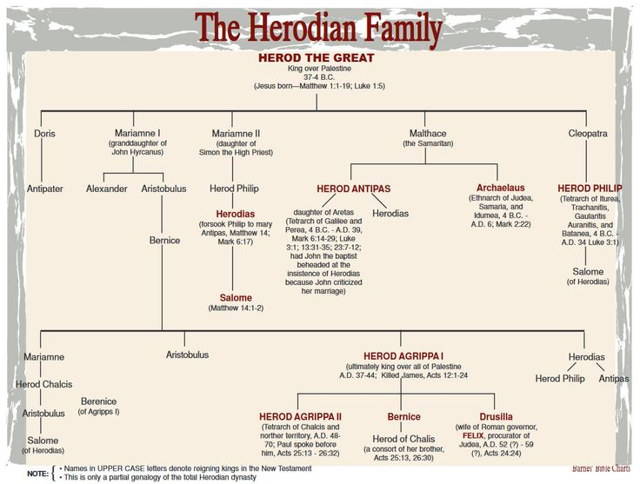

Wise Administrator
Rebuilt Temple
Granted Jews privileges
KILLED BABIES IN BETHLEHEM
m.
-Given Judea and Samaria
-Reigned when Joseph
brought family from Egypt
to Nazareth
m.
-Given portion
NE of Galilee

Slide 3
Pilate And The Roman Trial
Matthew 27:11-14; Mark 15:2-5; Luke 23:1-5;
John 18:28-38
Herod Antipas – Tetrarch (governor) of Galilee
One of the sons of Herod the Great. Matthew 2:1-16
  Wise men came from the East to worship the Christ child.
  Stopped at the palace of Herod the Great in Jerusalem.
  Scribes determined that the child would be born in Bethlehem of Judea (Micah 5:2)
  Warned to go home because Herod planned to harm the child.
  Herod the Great so furious he ordered all babies of Bethlehem slain up to two years old. Matthew 2:16

Slide 4
Herod the Great
Obsessed with establishing his dynasty
  Story of his life is strewn with the ghosts of people whom he suspected of treason or disloyalty.
  He has been described as “a madman who murdered his own family and a great many rabbis,” “the evil genius of the Judean nation,” “prepared to commit any crime in order to gratify his unbounded ambition” (Wikipedia)

Slide 5
Herod the Great
Cruel:
  Killed his father- in-law, two brothers-in-law, at least two sons, favorite wife.
  Killed the last in the Hasmonean dynasty.
  Professed to observe the law of Moses yet his life was a mockery to what it taught.
  Imprisoned chief men of the Jews and ordered that they be killed upon his death to ensure mourners at his death (not carried out).
Ordered the death of 45 members of the Sanhedrin who had opposed him.

Slide 6
Pilate And The Roman Trial
Matthew 27:11-14; Mark 15:2-5; Luke 23:1-5;
John 18:28-38
Herod Agrippa I – Tetrarch (governor) of Galilee
Had imprisoned and executed John the Baptist. Mark 6; Matthew 14
In Jerusalem for the Passover Feast, to please the Jews.
Only Luke records this. READ: Luke 23:6-16
  Herod a curiosity seeker.
  Mocked Jesus and arrayed Him in gorgeous apparel.
  Herod sent Jesus back to Pilate; became friends that day.
  NOTE: King Herod Agrippa I had charged Pilate with “corruptibility, violence, robberies, ill-treatment of the people, grievances, continuous executions without even the form of a trial, endless and intolerable cruelties” (Jack Finegan, Light From The Ancient Past, page 257).

Slide 7
Pilate And The Roman Trial
Matthew 27:11-14; Mark 15:2-5; Luke 23:1-5;
John 18:28-38
Pilate’s Judgment.
Luke 23:4, 14-15; John 18:38
Refused to pass judgment on a matter of Jewish law.
Found the charge of treason false.

Slide 8
Pilate And The Roman Trial
Matthew 27:11-14; Mark 15:2-5; Luke 23:1-5;
John 18:28-38
Pilate’s judgment.
Barabbas –
John 18:40, “a robber”
Mark 15:7, insurrectionist, murderer
Matthew 27:16, “a notable prisoner”
Pilate’s wife –
  Matthew 27:19, “And while he was sitting on the judgment-seat, his wife sent unto him, saying, Have thou nothing to do with that righteous man; for I have suffered many things this day in a dream because of him.”

Slide 9
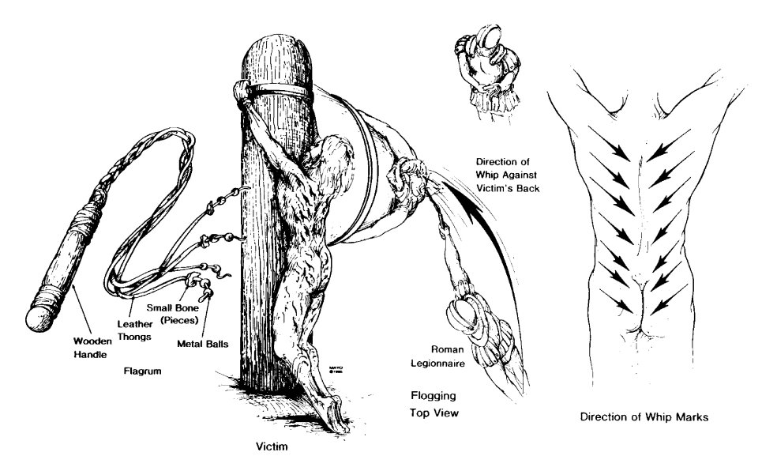
Pilate And The Roman Trial
Matthew 27:11-14; Mark 15:2-5; Luke 23:1-5;
John 18:28-38
Pilate’s judgment.
Luke 23:16, “I will therefore chastise him, and release him.”

Slide 10
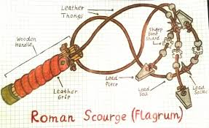
Pilate And The Roman Trial
Matthew 27:11-14; Mark 15:2-5; Luke 23:1-5;
John 18:28-38
Pilate’s judgment.
The Scourging. John 19:1-6
  Jews used rods. (limited to 40 stripes, Deuteronomy 25:1-3; cf. 2 Corinthians 11:24-25)
  Romans used a multiple thong whip, administered by two soldiers, number was not limited.
  John 19:16

Slide 11
Pilate And The Roman Trial
Matthew 27:11-14; Mark 15:2-5; Luke 23:1-5;
John 18:28-38
Pilate’s final judgment.
Matthew 27:24, “So when Pilate saw that he prevailed nothing, but rather that a tumult was arising, he took water, and washed his hands before the multitude, saying, I am innocent of the blood of this righteous man;
see ye (to it).”

Slide 12
Conclusion:
Pilate tried every method to release Jesus, but one!
Three times declared Him innocent. (Luke 23:4, 14, 22; John 18:38; 19:4, 6)
Sent Jesus to Herod.
Offered the release of a prisoner.
Had Jesus scourged.
  Washed his hands.
  “Wishing to content the multitude” (Mark 15:15)
  “see ye (to it).”
Isaiah 53:7, “He was oppressed, yet when he was afflicted he opened not his mouth; as a lamb that is led to the slaughter, and as a sheep that before its shearers is dumb, so he opened not his mouth.”

Slide 13
The Crucifixion
Matthew 27:35-38; Mark 15:24-28; Luke 23:33-34; John 19:18-24
October 5, 2022

Slide 14
Review
The Last Week Of Jesus’ Life
Friday: Jesus came to “Bethphage and Bethany at the Mount of Olives” (Mark 11:1), “six days before the Passover” (John 12:1).
Saturday: Sabbath. While in Bethany at the
house of Simon the Leper (Mark 14:3; Matthew 26:6), Mary anointed Jesus’ feet (John 12:3).

Slide 15
Review
The Last Week Of Jesus’ Life
Sunday: “The next day” (John 12:12-13),
Jesus entered the city on “a young colt” (John 12:14), went into the temple and “looked around,” but “it being now eventide (already late NASV)” he returned to Bethany (Mark 11:11).
Monday: On “the next day” he cursed the fig tree
(Mark 11:12), cleansed the temple (Mark 11:15- 18; Matthew 21:12-14) and “And every evening he went forth out of the city” (Mark 11:19).

Slide 16
Review
The Last Week Of Jesus’ Life
Tuesday: “In the morning” the fig tree was dried up
(Mark 11:20; cf. Matthew 21:18-22). Jesus then “came into the temple” (Matthew 21:23), was questioned about His authority.
He told three authority parables (21:23-22:14).
Jesus then discussed four questions
(Matthew 22:15-46) on the “same day” (Matthew 22:23), “while he taught in the temple” (Mark 12:35).

Slide 17
Review
Tuesday:
He warned the multitude about the scribes and Pharisees (Matthew 23:1-36), before he “went out of the temple” (Mark 13:1a) and taught on the Mount of Olives (Matthew 24:1-26:2) declaring “after two days is the Passover” when the events leading to his death began
(Matthew 26:2).
“And every day he was teaching in the temple; and every night he went out, and lodged in the mount that is called Olivet.” (Luke 21:37).

Slide 18
Review
The Last Week Of Jesus’ Life
Wednesday: “And all the people came early in the morning to him in the temple, to hear him.” (Luke 21:38).

Slide 19
Review
The Last Week Of Jesus’ Life
Thursday: Preparation was made to celebrate Passover on “the first day of the feast of unleavened bread” (Mark 14:12a; Matthew 26:17).
That night Jesus ate the “Passover” (Luke 22:15).
Thursday night into early Friday morning Jesus was arrested and tried before Caiaphas (Matthew 26:47-75).

Slide 20
Review
The Last Week Of Jesus’ Life
Friday: “When morning came,” Jesus was brought before Pilate (Matthew 27:1-2).
Presented to Herod.
He was crucified on “Preparation Day” (John19:31; Luke 23:54) which is also called the “day before the Sabbath” (Mark 15:42).

Slide 21
Crucifixion:
Sometimes the victim was tied to the cross and then left to die of starvation.
Sometimes the condemned was laid against the wooden crossbeam and nails were driven through the hands into the wood.
A foot was pressed backward against the other foot and a large nail was driven through the arch of the feet into the post.

